Slide 1
Metal Oxide Semiconductor Field-Effect Transistor

Slide 2
MOSFET: Metal Oxide Semiconductor Field-Effect Transistor
n channel MOSFET
In lightly doped p-type substrate, two highly doped n regions (source and drain) are diffused
Insulator is grown over surface and holes are cut into it to have contact with source and drain
For Si substrate, SiO₂ is used as the Insulator

Slide 3
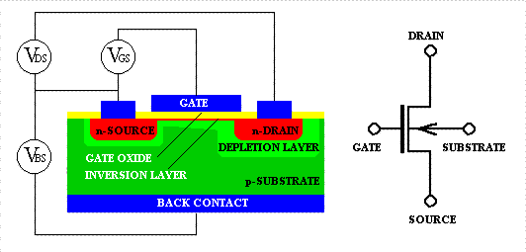
Metal-Oxide-Semiconductor Field-Effect Transistor (MOSFET)
n-channel

Slide 4
(+)
MOSFET operation
Substrate: Grounded
Gate : + ve voltage
+ + + + + + + + + + + + +
_ _ _ _ _ _ _ _ _ _
+ + + + + + + + + + + +
- - - - - - - - - - - -
An electric field is directed perpendicularly through oxide
Negative charge is induced on semiconductor
A channel is formed between drain and source
Width of channel depends on gate voltage
Induced channel

Slide 5
Electrons may flow through Channel

Slide 6
Basic Operation
1) Source and substrate grounded (zero voltage)
2) (+) voltage on the gate
Attracts e⁻s to Si/SiO2 interface; forms channel
3) (+) voltage on the drain
e⁻s in the channel drift from source to drain
current flows from drain to source

Slide 7
MOSFET
Metal-oxide-semiconductor field-effect transistor
G = gate, D = drain, S = source, B = body (substrate)

Slide 8
N enhance FET at Pinchoff

Slide 9
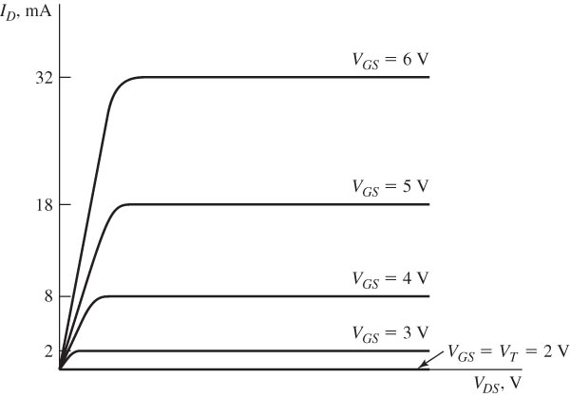
Drain characteristics for an ideal representative N-channel enhancement-mode MOSFET.

Slide 10
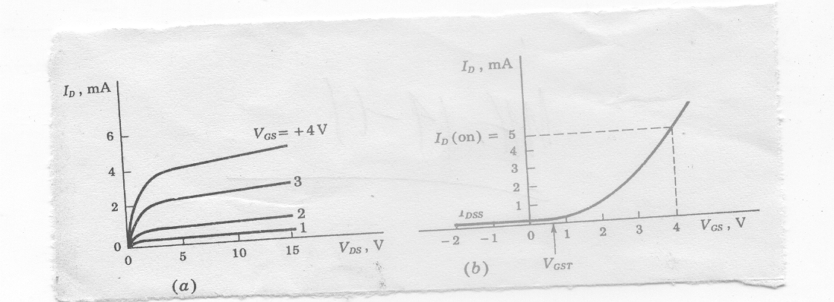
(a) I_{D} versus V_{DS} (b) I_{D} versus V_{GS} for a fixed V_{DS}
As V_{GS} is made positive I_{D} increases slowly at first and then much rapidly
I_{D} reaches significant value (some predefined small ) at threshold voltage

Slide 11
N channel Depletion mode FET ON – No gate bias
A channel is diffused between source and Drain

Slide 12
(- ve)
Channel Depletion with application of
negative voltage
- - - - - - - - - - - - - - -
+ + + + + + + + + + + + + + + +
- - - - - - - - - - - - - - - - - - - - - - - - - -
Induced +ve charge makes the channel less conductive
Causes effective depletion of majority carriers
Analogous to JFET characteristics
+ + + + + + + + + + + + + + +
+ + + + + + + + + + +
+ + + + +

Slide 13
N channel Depletion mode FET off

Slide 14
nMOS Cutoff
No channel
I_{ds} ≈ 0

Slide 15
nMOS Linear
Channel forms
Current flows from d to s
e⁻ from s to d
I_{ds} increases with V_{ds}
Similar to linear resistor

Slide 16
nMOS Saturation
Channel pinches off
I_{ds} independent of V_{ds}
We say current saturates
Similar to current source

Slide 17
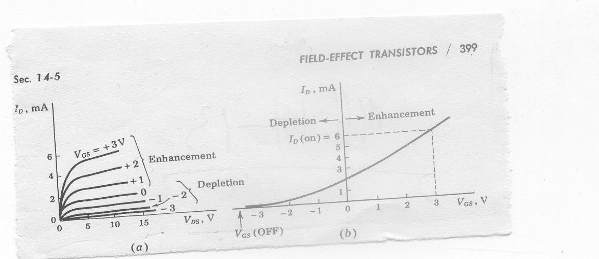
N channel Depletion mode MOSFET
(a) I_{D} versus V_{DS} (b) I_{D} versus V_{GS} for a fixed V_{DS}
May be used for both enhancement and depletion mode
Lower threshold voltage than enhancement type

Slide 18
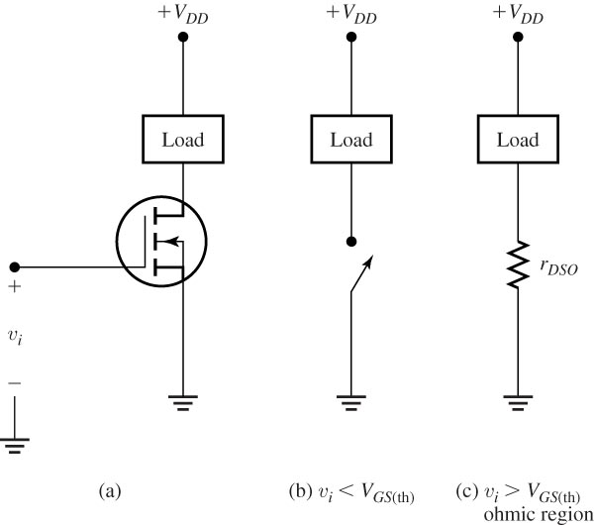
Switch using an N-channel enhancement-mode MOSFET.

Slide 19
Comparison between p- with n-channel FET
p-channel is easier to fabricate
n-channel is faster as the mobility of electrons is 3 times greater than the mobility of holes
n-channel takes less space

Slide 20
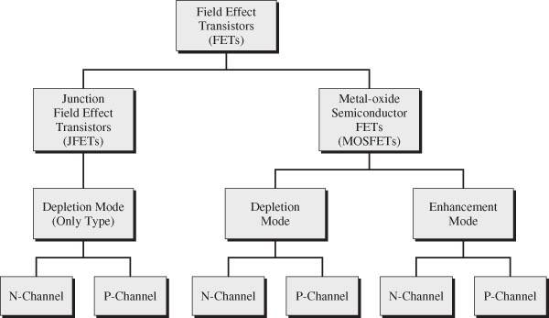
Classification scheme for field effect transistors

Slide 21
Terminal Voltages
Mode of operation depends on V_{g}, V_{d}, V_{s}
V_{gs} = V_{g} – V_{s}
V_{gd} = V_{g} – V_{d}
V_{ds} = V_{d} – V_{s} = V_{gs} - V_{gd}
Source and drain are symmetric diffusion terminals
By convention, source is terminal at lower voltage
Hence V_{ds} ≥ 0
nMOS body is grounded. First assume source is 0 too.
Three regions of operation
Cutoff
Linear
Saturation

Slide 22
nMOS Cutoff
No channel
I_{ds} ≈ 0

Slide 23
nMOS Linear
Channel forms
Current flows from d to s
e⁻ from s to d
I_{ds} increases with V_{ds}
Similar to linear resistor

Slide 24
nMOS Saturation
Channel pinches off
I_{ds} independent of V_{ds}
We say current saturates
Similar to current source

Slide 25
I-V Characteristics
I_{ds} is dependent on both V_{ds} and V_{gs}
In Linear region, I_{ds} depends on
How much charge is in the channel?
How fast is the charge moving?

Slide 26
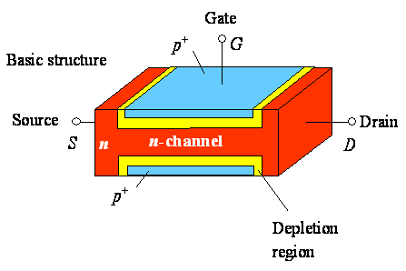
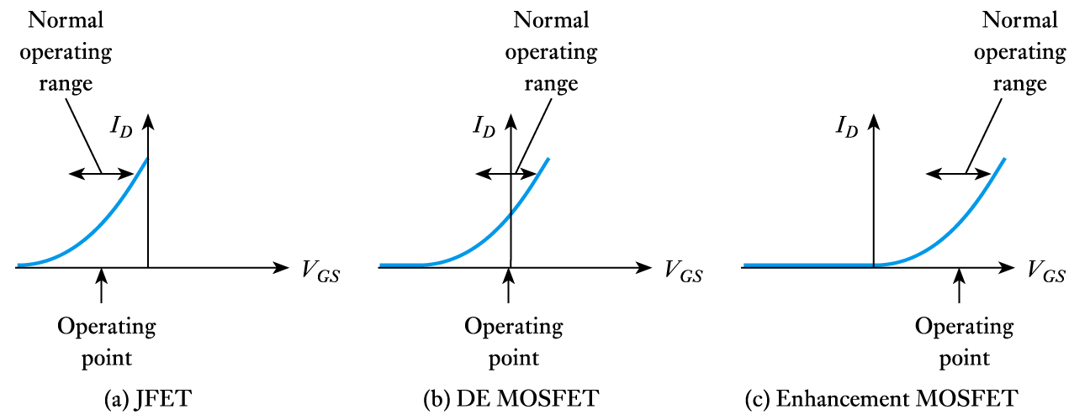
Transfer characteristics (n channel FET)
D
G
S
Operating range decides the type of FET

Slide 27
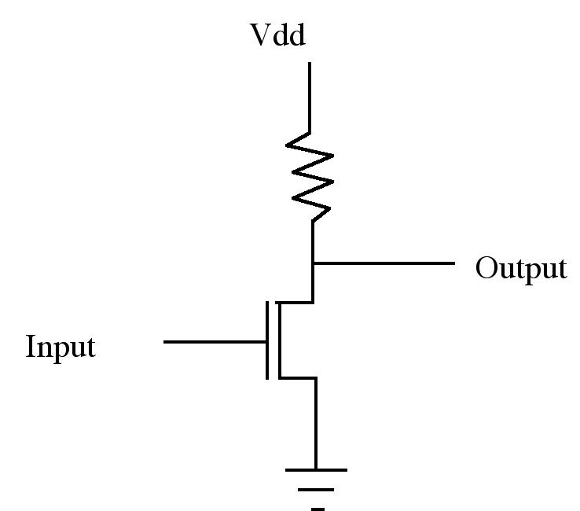
NMOS Inverter
Enhancement NMOS: (a) I_{D} versus V_{DS} (b) I_{D} versus V_{GS}
Inverter Operation
- Plus signal input turns transistor on
- Ground is connected to output, thus a 1 (+) in gives 0 (Gnd) out
- A 0 input opens transistor and output is pulled high by resistor

Slide 28
NMOS Inverter
Resistor dissipates heat
Fabrication of resistor is not easy
Even modest values of Resistors occupy excessively large areas in silicon substrate

Slide 29
A transistor may be used as a resistor
V_{DD}
Pull up
Output
Input
Pull down
In Pull down NMOS
For input=1, Pull down conducts
For input =0, Pull down is off

Slide 30
V_{DD}
Pull up as an enhancement type NMOS
Pull up transistor input (V_{GG}) should be high
V_{GG}
Pull up
Output
Input
Pull down

Slide 31
Pull up as an enhancement NMOS
V_{out}
V_{DD}
V_{DD}
V_{tpu}
V_{GG}
Pull up
Output
Input
Pull down
Non zero output
V_{tpd}
V_{in}
Dissipation is high since current flows when input=1
V_{out} can never be zero
V_{out} can never reach VDD (logical 1) if V_{GG}=V_{DD} as is normally the case
If V_{GG} is higher than V_{DD}, then an extra rail is required

Slide 32
Depletion type NMOS is used in pull up for better performance
V_{DD}
Gate and Source is shorted to achieve V_{GS}=0
In Pull down NMOS
For input=1, Pull down is on
For input =0, Pull down is off
Pull up is always on
Output
Input

Slide 33
Depletion type NMOS is used in pull up for better performance
V_{DD}
V_{out}
V_{DD}
No current
Output
Current flows
Input
Non zero output
V_{tpd}
V_{in}
Dissipation is high since current flows when input=1
V_{out} can never be zero

Slide 34
Drawbacks of Metal-gate MOS Transistors
High current flow for input at logic 1 in case of an inverter
Excess surface state charges and mobile ion contamination cause the threshold variation.
V_{out} never becomes exactly zero
Suffer from excessive overlap capacitance.
Parasitic capacitances C_{gs} and C_{gd} slow the transistor because they must be charged and discharged during switching.
Aluminum is used as gate material which can erode completely causing contact spiking.

Slide 35
Complementary MOS Transistors (CMOS)
V_{DD}
p
When A is pulled high (V_{DD}), the PMOS inverter is turned off, while the NMOS is turned on pulling the output down to V_{SS}
When A is pulled low (V_{SS}), the NMOS inverter is turned off, while the PMOS is turned on pulling the output up to V_{DD}
A
Y = A'
n
GND

Slide 36
Complementary MOS Transistors (CMOS)
V_{out}
V_{DD}
V_{DD}
p
p on
n off
n on
p off
A
Y = A'
Both on
n
GND
V_{tpd}
V_{in}
No current flow either for logical 0 or for logical 1 inputs
Full logical 1 and 0 levels are presented at output
For devices of similar dimension p-channel is slower than n-channel device

Slide 37
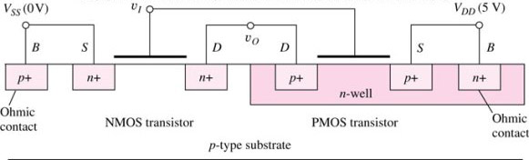
Complementary MOS Transistors (CMOS)
V_{DD}
S
G
p
D
A
Y = A'
D
n
G
S
GND

Slide 38
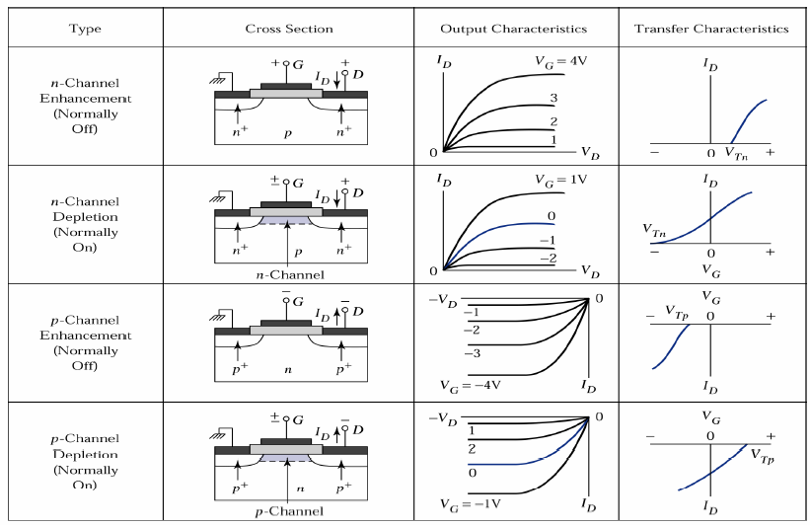
Types of MOSFET
Pullup may be enhancement type PMOS

Slide 39
CMOS Inverter Technology
Complementary MOS, or CMOS, needs both PMOS and NMOS devices for their logic gates to be realized
The concept of CMOS was introduced in 1963 by Wanlass and Sah, but it did not become common until the 1980’s as NMOS microprocessors were dissipating as much as 50 W and alternative design technique was needed
CMOS still dominates digital IC design today

Slide 40
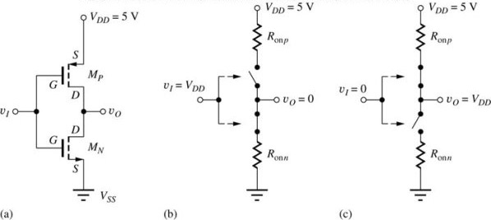
CMOS Inverter
Circuit schematic for a CMOS inverter
Simplified operation model with a high input applied
Simplified operation model with a low input applied

